Slide 1
Fit – Part 2

Slide 2
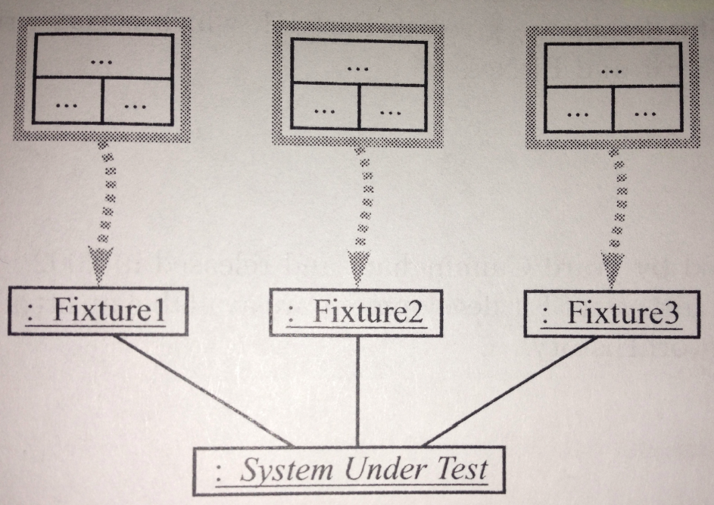
Fit architecture overview
User defined tables

Slide 3
Fit architecture overview
User defined tables
Programmer defined mapping

Slide 4
Fit architecture overview
User defined tables
Programmer defined mapping
SUT

Slide 5
ColumnFixture Example 1
Business rule
A 5 percent discount is provided whenever the total purchase is greater than $1,000

Slide 6
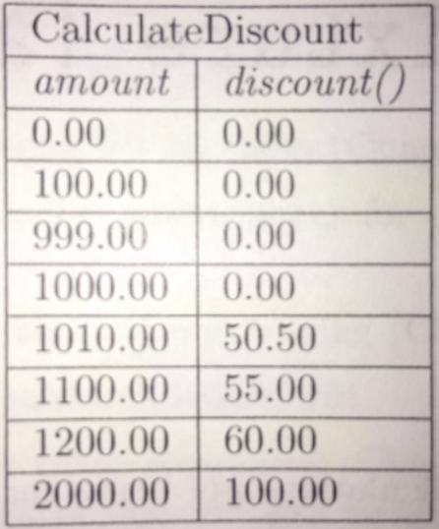
Reading a ColumFixture table
Fixture
given column name
calculated column name
test rows

Slide 7
Goal for a ColumnFixture Class
The goal is to
Map the “given” columns from the table to the appropriate instance variables
Map the “calculated” columns from the table to the appropriate methods

Slide 8
The ColumnFixture Class
public class CalculateDiscount extends fit.ColumnFixture {
public double amount;
private Discount sut = new Discount();
public double discount() {
return sut.getDiscount(amount);
}
}

Slide 9
Inheritance
public class CalculateDiscount extends fit.ColumnFixture {
public double amount;
private Discount sut = new Discount();
public double discount() {
return sut.getDiscount(amount);
}
}

Slide 10
Fixture Name
public class CalculateDiscount extends fit.ColumnFixture {
public double amount;
private Discount sut = new Discount();
public double discount() {
return sut.getDiscount(amount);
}
}

Slide 11
Given Column Name
public class CalculateDiscount extends fit.ColumnFixture {
public double amount;
private Discount sut = new Discount();
public double discount() {
return sut.getDiscount(amount);
}
}
Notice this is a public instance variable
This violates OO principles but it is only for the test class not the SUT

Slide 12
Calculated Column Name
public class CalculateDiscount extends fit.ColumnFixture {
public double amount;
private Discount sut = new Discount();
public double discount() {
return sut.getDiscount(amount);
}
}
This also has to be public
Notice that it does not exactly match the method called on the SUT

Slide 13
Link to the SUT
public class CalculateDiscount extends fit.ColumnFixture {
public double amount;
private Discount sut = new Discount();
public double discount() {
return sut.getDiscount(amount);
}
}

Slide 14
What happens under the hood
When we run Fit against our project
Fit creates an instance of our fixture class
Since our fixture class is a subclass of fit.ColumnFixture it has a method inherited called doTable()
Fit calls doTable which then uses the test row data to
Set the public amount variable to the data in the “given” column in a test row
Check that the mapped to method, in this case discount(), returns the expected value in the row’s “calculated” column

Slide 15
Repetition
Fit does the previous slide’s activity
For each test row in the ColumnFixture table
For each table in the directory

